Slide 1
ThesisVault
BACKEND
Flask + SQLAlchemy
Multi-Tenant SaaS · Subscription & Feature Entitlement System
Design · Implementation · Live Deployment
FRONTEND
Vue 3 + Tailwind CSS
Full Stack Development Apprentice Assessment | Migri Technologies
Devendra Kumar · 21F2000575 | March 31, 2026
QUEUE
🌐 thesisvault.live
Celery + Redis
AI
Gemini 2.5 Flash
INFRA
Nginx + Gunicorn

Slide 2
Problem Statement
What we were asked to design and build
Challenge
Requirements
• Multi-tenant SaaS needs subscription-based access control
• Multiple organizations with strict tenant isolation
• Feature entitlements and usage limits per plan
• Database-driven plans (no hardcoded logic)
• API-level enforcement — not just frontend hiding
• Race condition-safe usage tracking
Production Concerns
Our Answer
• Plan upgrade / downgrade lifecycle
• ThesisVault — Thesis Project Management Platform
• Grace period & maintenance mode support
• 3 middleware decorators, 14 DB tables, full lifecycle
• Immutable audit trail for compliance
• Live at https://thesisvault.live

Slide 3
System Architecture
Full request lifecycle from browser to database
Vue 3 SPA
Nginx
Flask API
MySQL
JWT in header
→
HTTPS + proxy
→
Blueprint routes
→
Tenant-scoped queries
Middleware Stack (applied in order on every protected route)
@auth_token_required
@subscription_required
@requires_feature('ai_analysis')
@limit_check(org_attr, plan_attr)
Token valid? Not revoked?
Org active? Not expired?
Plan has this feature?
Usage within quota?
AI Pipeline:
Email Pipeline:
Flask → Redis → Celery Worker → Gemini 2.5 Flash → DB
Flask → Celery Worker → Flask-Mailman → Gmail SMTP

Slide 4
Multi-Tenant Isolation Strategy
How tenant data is separated and secured
Logical Isolation
Security Validation
• Every table has organization_id FK
• Global @before_flush SQLAlchemy event hook
• All API queries scoped by current org
• Validates org_id on every DB write operation
• Shared database — cost-effective SaaS model
• Prevents cross-org submission injection
• No cross-org data leakage possible
• Blocks enumeration / ID scanning attacks
Race Condition Prevention
Token Security
• Never: org.active_projects += 1 (unsafe)
• Authentication-Token header (not Bearer)
• Always: UPDATE SET count = count + 1
• RevokedToken table checked on every request
• Atomic SQL prevents concurrent over-limit
• Argon2 password hashing (OWASP recommended)
• Safe at 500+ concurrent requests per org
• Soft deletes — deleted_at on all models

Slide 5
Subscription Plan Modeling
Database-driven — add new plans without modifying code
Feature
Free
Pro
Enterprise
Active Projects
3
50
Unlimited
Max Students
50
500
Unlimited
AI Evaluations / Month
❌
100
Unlimited
Grace Period
❌
✅
✅
Maintenance Mode
❌
✅
✅
Subscription History
✅
✅
✅
✅ Plans stored in DB · features column = JSON map · Add new plan = one INSERT statement — zero code changes

Slide 6
API-Level Entitlement Enforcement
3 decorators gate every protected route — frontend restriction is NOT enough
@subscription_required
@requires_feature('ai_analysis')
@limit_check('active_projects', ...)
• Checks org.status == 'active'
• Reads plan.features JSON map
• Compares org.active_projects vs plan limit
• Validates subscription_ends_at not expired
• Checks legacy has_ai_feature column too
• Generic — any org/plan attribute pair
• Grace period: temp access post-expiry
• Extensible — new feature = no schema change
• Returns HTTP 403 with upgrade message
• Returns HTTP 403 with error message
• Returns HTTP 403 Feature not in your plan
• Enforced BEFORE any DB write occurs
Real Route Example
@submissions_bp.route('/evaluate/<id>', methods=['POST'])
@auth_token_required
@subscription_required
@requires_feature('ai_analysis')
@limit_check('monthly_ai_count', 'monthly_ai_limit')
def trigger_ai_evaluation(id): # Runs only if ALL 4 pass

Slide 7
Subscription Lifecycle Management
Full state machine with upgrade / downgrade logic
●
●
●
●
ACTIVE
EXPIRED
GRACE PERIOD
MAINTENANCE
→
→
→
Full plan access
Premium features blocked
Temp access post-expiry
Admin kill switch
Plan Upgrade / Downgrade Logic
Monthly AI Usage Reset
• Usage-based rejection before downgrade
• org.monthly_ai_count tracked per organization
• If active_projects > new plan limit → block
• Auto-resets when month changes on next request
• Downgrade from Pro → Free blocked if limit exceeded
• No cron job needed — lazy evaluation on access
• All changes recorded in SubscriptionHistory
• Checked inside is_subscription_valid property
• ActivityLog captures every admin action
• plan.monthly_ai_limit enforced via @limit_check
• change_reason stored for audit trail
• Reset sets last_usage_reset = now()
• API: GET /api/admin/organizations/me/history
• Fully automatic — transparent to the user

Slide 8
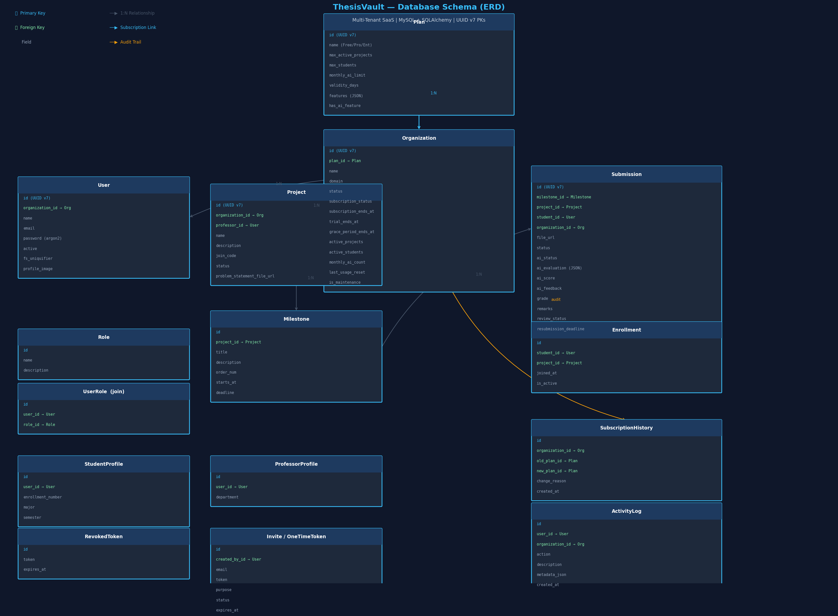
Database Schema
14 tables · UUID v7 PKs · Soft deletes · Multi-tenant scoped
Plan
Subscription plans + limits
Organization
Tenant + subscription state
User + Roles
RBAC with M:N UserRole join
Project
Professor-owned, org-scoped
Milestone
Ordered project checkpoints
Submission
AI evaluation + review
Enrollment
Student ↔ Project M:N link
SubscriptionHistory
Immutable plan change log
ActivityLog
Admin action tracker

Slide 9
Live Deployment
Production-grade infrastructure on Ubuntu VPS
🌐 https://thesisvault.live
CLIENT
PROXY
Vue 3 SPA
Nginx + Let's Encrypt
Browser sends Authentication-Token header on every request
HTTPS termination, reverse proxy, static file serving, SSL cert
APP
QUEUE
Gunicorn (3 workers)
Celery + Redis
Flask WSGI server, systemd-managed, auto-restart on crash
Async AI evaluation tasks and professor invite email pipeline
DATABASE
AI
MySQL 8.0
Gemini 2.5 Flash
Multi-tenant scoped, UUID v7 PKs, soft deletes on all tables
PDF thesis analysis, structured JSON evaluation feedback output

Slide 10
Compliance & Audit Trail
Every subscription action is logged and traceable
SubscriptionHistory Table
ActivityLog Table
• Records every plan upgrade / downgrade
• Tracks: ORG_REGISTERED, PLAN_CHANGED
• Stores old_plan_id, new_plan_id, change_reason
• PROJECT_CREATED, PROJECT_STATUS_CHANGED
• Immutable — insert only, never updated
• user_id + organization_id on every record
• Timestamps stored in UTC timezone
• metadata_json for extra structured context
• API: GET /api/admin/organizations/me/history
• action field is a short uppercase constant
• Used for compliance and billing disputes
• Returns last 50 entries via admin API
Why This Matters
• Compliance reviews — full plan change history available on demand at any time
• Debugging — trace exactly when a limit was hit, a plan changed, or a user was blocked
• Trust — organizations can verify every subscription transition transparently
• SaaS standard — required for enterprise-grade entitlement systems at production scale

Slide 11
Design Rationale & Scalability
Architectural decisions and the reasoning behind them
Shared DB + Logical Isolation
JSON Features Column
Cost-effective, easier to manage, allows cross-tenant analytics. Standard approach for early-stage SaaS.
Add new entitlements (e.g., video_review, pdf_export) by updating a JSON value — zero schema migrations.
Atomic SQL Increments
UUID v7 PKs
UPDATE SET count = count + 1 at DB level prevents race conditions when 100s of users act simultaneously.
Time-sortable, globally unique, avoids enumeration attacks, and works cleanly in distributed setups.
Decorator-Based Middleware
Soft Deletes (deleted_at)
Composable, reusable, and testable. Adding a new access rule = one decorator line on the route.
Enables data recovery, audit compliance, and prevents orphan records in a multi-tenant database.

Slide 12
Implementation Highlights
Every assessment requirement delivered
✅ Backend
✅ Frontend
Flask + SQLAlchemy + 3 core entitlement decorators
Vue 3 SPA — real-time subscription dashboard + role-based UI
✅ Database
✅ AI Pipeline
MySQL + 14 tables + full multi-tenant isolation + audit
Gemini 2.5 Flash PDF analysis via async Celery worker queue
✅ Email System
✅ Plan Management
Flask-Mailman + Gmail SMTP + professor onboarding invite flow
Upgrade / downgrade with usage-based rejection enforcement
✅ Lifecycle States
✅ Audit Trail
Active, Expired, Grace Period, Maintenance mode — full state machine
SubscriptionHistory + ActivityLog — immutable, timestamped records
✅ Token Security
✅ Live Deployment
Revocation table + Argon2 hashing + per-request validation
Ubuntu VPS + Nginx + Gunicorn + systemd + Let's Encrypt SSL

Slide 13
Thank You
Questions & Discussion Welcome
🌐 Live Demo
https://thesisvault.live
👤 Author
Devendra Kumar · 21F2000575
🏢 Assessment
Migri Technologies — Full Stack Apprentice 2026
14
3
4
2
DB Tables
Decorators
Lifecycle States
Async Pipelines

